Slide 1

Audio To SignLanguage Converter
Presented by:
Abhay KS
Clinet Rovea Ross
Chris Benny
Jenson Jose

Slide 2
INTRODUCTION
There are 135 types of sign languages all over the world. We are using Indian Sign Language in this Project.
This application takes speech as input, converts it into text and then displays the ISL by animation which is created using 3D BLENDER TOOL

Slide 3
EXISTING MODEL
These models, such as audio-to-ISL converter and speech-to-sign language system for showcase various approaches but often face limitations, including complexity and reduced accuracy.

Slide 4
PROPOSED MODEL
Improved Educational Opportunities.
Employment Inclusivity.
Wider Information Access.
Independence and Autonomy.
Local languanges also can be coverted.

Slide 5
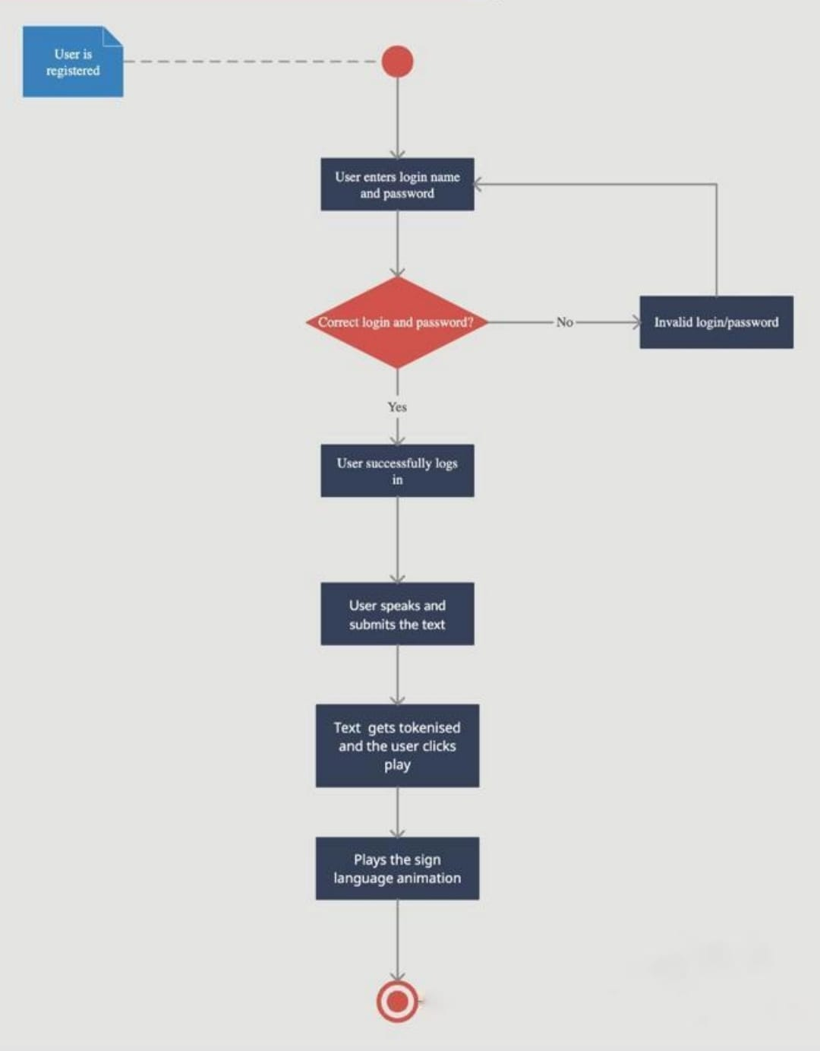
ACTIVITY DIAGRAM

Slide 6
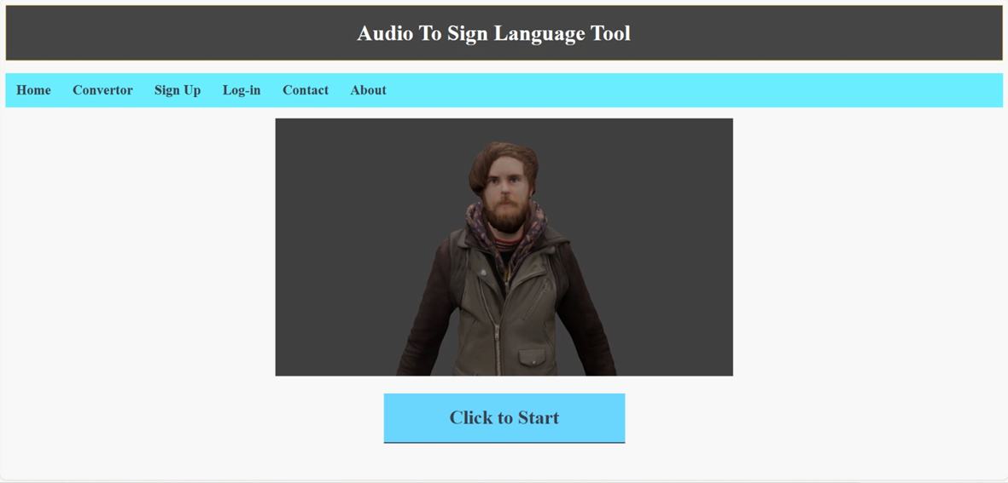
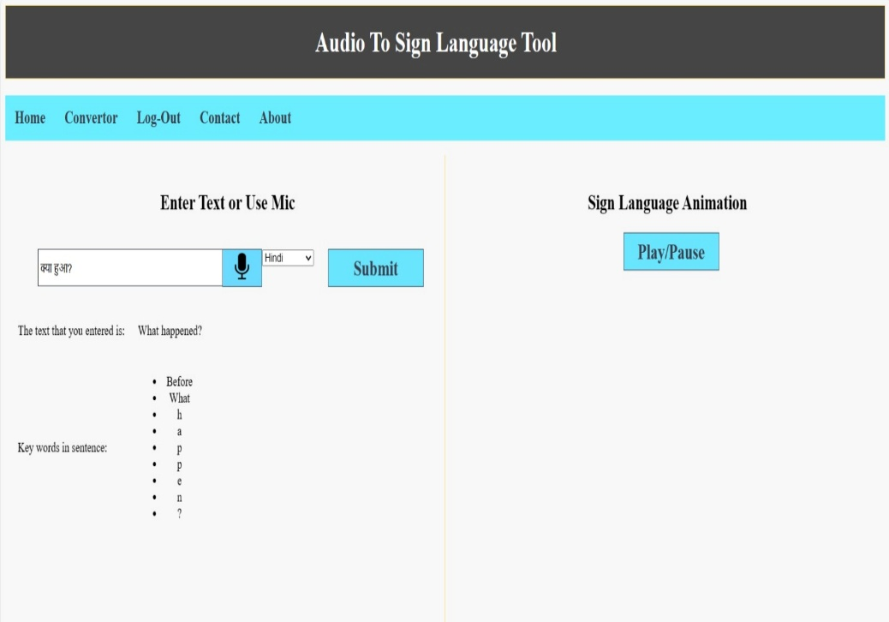
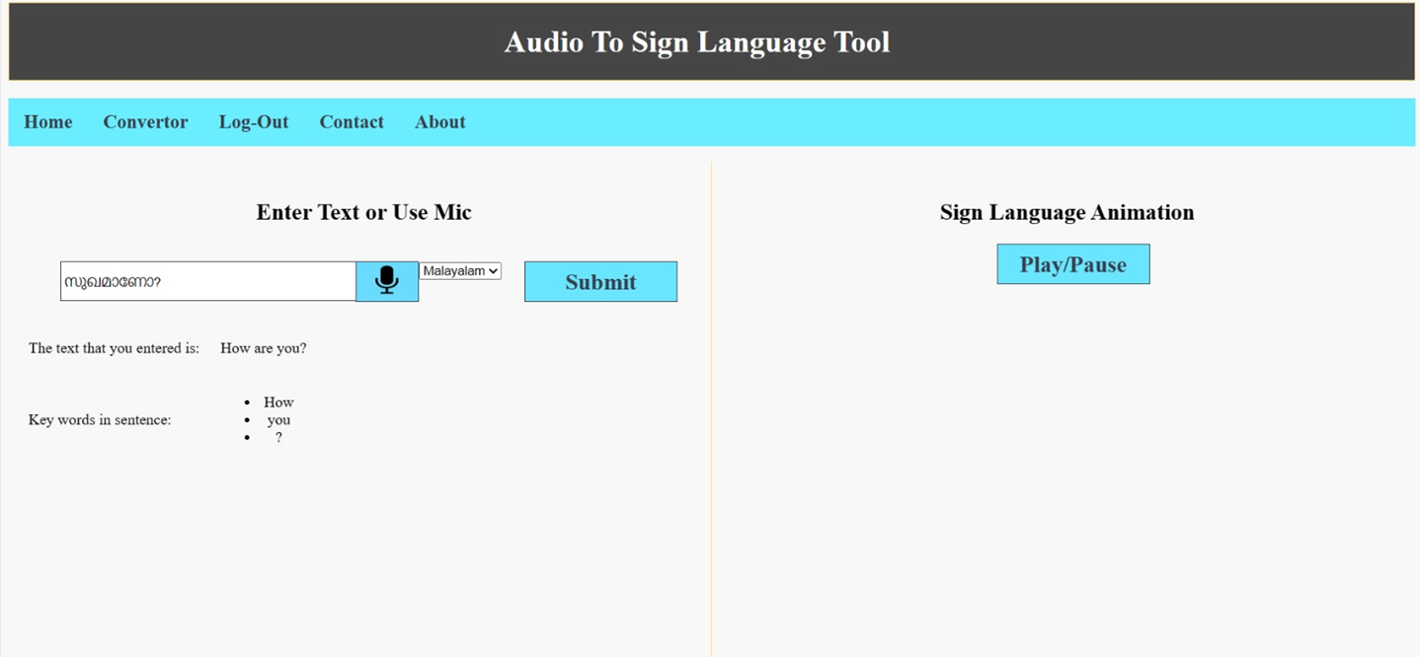
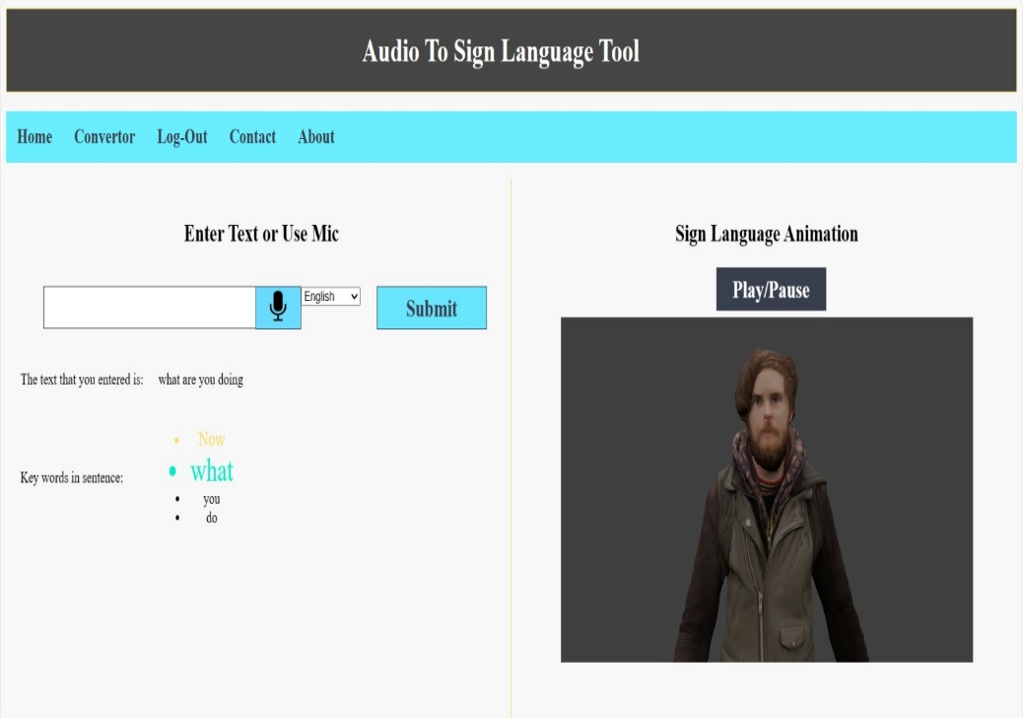

Slide 7
FUTURE SCOPE
Sign language translator can be used in schools, colleges, hospitals, universities, airports, courts anywhere anyone can use this system for understanding the sign language to communicate.
The future work is to develop an application where in the news channels can use it while giving news, in one corner of the screen it will be displayed in sign language for deaf people.
So this will be better idea which we can give to news channels.

Slide 8
REFERENCES
Huang, Y., Zhang, M., Huang, H., & Zhu, J. (2021). Audio-to-Sign Language Translation Based on Deep Learning.
Rathore, P., Singh, A., & Saini, M. (2020). Real-Time Conversion of Speech to Sign Language using Deep Learning.
Saxena, A., & Reddy, K. V. (2019). Audio to Sign Language Conversion using Deep Learning and Hand Gesture Recognition.

Slide 9
THANK YOU

